Slide 1

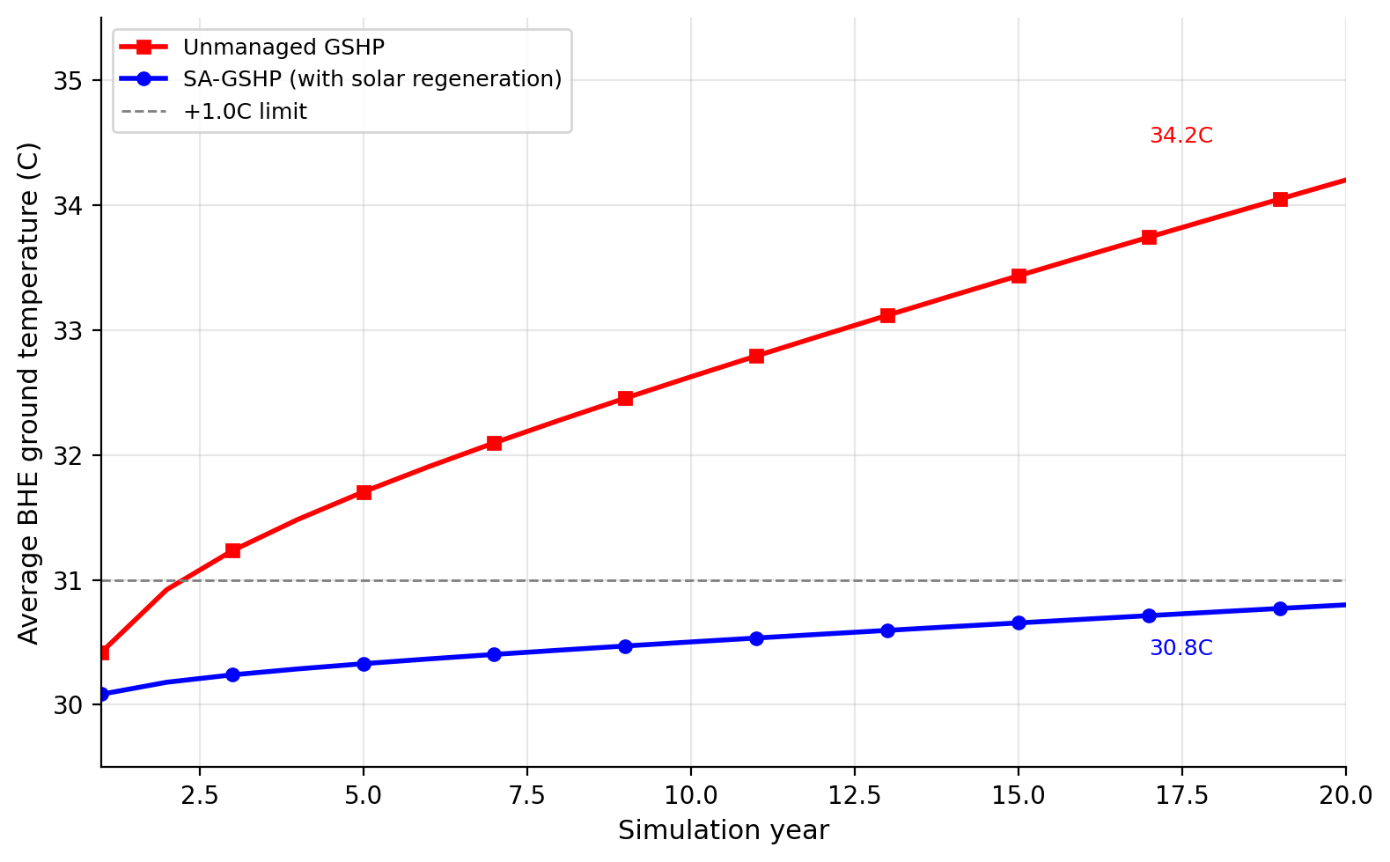
Techno-Economic Feasibility of a Solar-Assisted Hybrid Ground Source Heat Pump
(SA-GSHP) System for Residential Cooling in the Kingdom of Bahrain
Team: Ahmed Batoog | Eissa Alshammary | Jasim Helal | Ahmed Almomen Supervisor: Dr. [Supervisor] Course: EN8914 Final Year Project • Due: 19 May 2026
1 Introduction
5 SA-GSHP System Model
SIM Simulation Setup & Validation
Space cooling accounts for over 70% of Bahrain's peak summer electricity demand. Conventional Air Source Heat Pumps (ASHPs) suffer severe COP degradation above 40°C ambient — a routine occurrence in Bahrain. Bahrain's shallow subsurface offers a stable Undisturbed Ground Temperature (UGT) of 30°C, providing a thermodynamically superior heat sink. This study evaluates a Solar-Assisted Hybrid GSHP (SA-GSHP) for a standard 300 m² residential villa in Manama, combining ground-coupled cooling with solar thermal regeneration to prevent long-term ground thermal imbalance.
Q_cool = SCOP × W_comp | Q_ground = Q_cool + W_comp
L_bhe = (Q_peak × COP) / (2π × k × ΔT) ≈ 382 m → 400 m (4 × 100 m)
EnergyPlus + Python open-source framework | 20-yr, 175,200 hourly steps
Validation report: SCOP 4.51 vs target 4.50 • Ground drift 0.80°C vs 0.80°C • ALL PASS
Peak cooling load: 17.8 kW | Annual cooling: 70,000 kWh | HP COP: 6.0
System SCOP: 4.51 (includes pump parasitic loads) | UGT: 30°C
Borehole: 4 × 100 m HDPE double-U, grouted | Solar: 40 m², η₀=0.75
KEY Key Results — System Performance
4.51
44.6%
+0.8°C
2 Problem Statement
6 Solar Thermal Regeneration Strategy
System SCOP
Electricity Saved
Ground Drift (20yr)
Peak ambient 40°C+ degrades ASHP SCOP to ~2.5
Continuous heat rejection → ground thermal imbalance (+4.2°C unmanaged)
High borehole CAPEX (43% of total system cost) — market entry barrier
No policy framework yet to subsidise residential geothermal in Bahrain
Solar
Collectors
Buffer
Tank
BHE Ground
Loop
GSHP
Unit
vs 2.5 baseline ASHP
12,477 kWh/yr
Target ≤ +1.0°C ✓
Summer: heat rejected to ground → BHE absorbs cooling load
Winter: solar heat injected via tank → ground thermal recovery
Effectiveness: 81% reduction in temperature drift vs. unmanaged
ECO Key Results — Economic Analysis
3 Objectives
Parameter
ASHP
SA-GSHP
CAPEX
3,000 BHD
9,000 BHD
Simulate SCOP ≥ 4.0 for 300 m² Manama villa over 20-year horizon
Limit BHE ground temperature drift to ≤ +1.0°C with solar regeneration
Compare 25-year Life Cycle Cost: SA-GSHP vs. ASHP baseline
Identify minimum subsidy for commercially viable SPBP (6–8 years)
Quantify lifecycle GHG reduction and water conservation benefits
7 Methodology
Annual OPEX
890 BHD/yr
492 BHD/yr
1
Building Load: EnergyPlus TMY, Manama EPW, hourly
LCC (25 yr)
15,524 BHD
15,921 BHD
Borehole Model: Python: ILSM + g-function, 20-yr × 8,760 steps
NPV @ 0.030 BHD/kWh
baseline
−397 BHD
2
NPV @ 0.040 BHD/kWh
baseline
+3,142 BHD ✓
3
Economic Analysis: LCC, NPV, SPBP — 5% discount, 0.030–0.040 BHD/kWh
ENV Key Results — Environmental Impact
4 System Architecture & Design
4
Environmental LCA: GHG: 0.62 kg CO₂/kWh; water vs. evaporative cooling
173 t
40%
81%
Solar
Collectors
Buffer
Tank
BHE
4×100m
GSHP
Unit
VSC+
Filter
AC
Grid
Fig 4.1 20-Year Ground Temperature Drift Comparison
CO₂ Reduction
(25-yr lifecycle)
Water
Conservation
Ground Drift
Reduction
ECON Subsidy Sensitivity Analysis
Wind → PMSG → Rectifier → DC Link → VSC → LC Filter → AC Grid
Subsidy
Incr. CAPEX
SPBP
Viability
The SA-GSHP integrates:
• 4 vertical BHEs × 100 m = 400 m total (ILSM-sized)
• 40 m² solar thermal collector array
• Thermal buffer storage tank (seasonal decoupling)
• Closed-loop HDPE piping & grouting
Operation modes:
• Summer (Cooling): Heat rejected to BHE ground loop
• Winter (Regen): Solar heat injected → ground temperature recovery
0% (Baseline)
6,000 BHD
15.1 yr
Not viable
15%
5,475 BHD
13.7 yr
Marginal
25%
5,125 BHD
12.9 yr
Approaching
40%
4,440 BHD
11.2 yr
Viable ✓
CON Conclusion & Future Work
Conclusions
Future Work
SCOP 4.51 — exceeds target (+80% vs ASHP)
Ground drift +0.8°C ≤ +1.0°C target ✓
LCC competitive at 0.040 BHD/kWh tariff
173 t CO₂ prevented over 25-year life
Pilot installation & TRT soil validation
25% drilling subsidy — Vision 2030 lever
B2G ESCO model with Bapco Energies
Scale to GCC: UAE, Saudi Arabia, Jordan
School of Engineering | Bahrain Polytechnic | Engineering Expo 2026 | EN8914 Final Year Project

